Slide 1
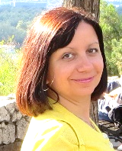
Sonja Jovanović
Primary School “Čegar” Niš
4th grade “Discover English 1”
Unit 7
Happy Birthday

Slide 2
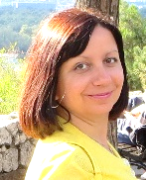
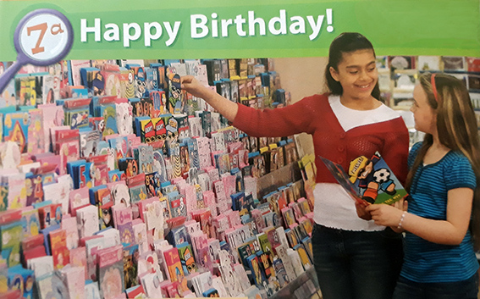
Open your book, p. 64, ex. 1. Listen carefully.
Sonja Jovanović
Primary School “Čegar” Niš
NEW WORDS:
Look for
Card
You’re right!
Remember
How about
That isn’t fair!
That’s a great idea!
tražiti
čestitka
u pravu si
pamtiti, sećati se
kako bi bilo da
to nije fer
to je sjajna ideja

Slide 3
Sonja Jovanović
Primary School “Čegar” Niš
Now let’s do ex. 2 , True / False:
1. Monica and Gemma are in a café.
false
2. It’s Ben’s birthday today.
true
3. Monica is buying Ben a card.
true
4. Ben doesn’t like rock music.
false
5. Ben’s got a lot of McFly CDs.
true
6. Gemma’s birthday isn’t in June.
false

Slide 4
Let’s look at p. 65 in your book:
Sonja Jovanović
Primary School “Čegar” Niš
Grammar: Frequency Adverbs
(Prilozi učestalosti)
Always - uvek
He always listens to Shakira.
Usually - obično
He usually listens to rock music.
Often - često
She often listens to the radio.
Sometimes - ponekad
He sometimes listens to music.
Never - nikad
I never remember birthdays.

Slide 5
Homework: Copy the new words and do p. 56 in your workbook.
Sonja Jovanović
Primary School “Čegar” Niš
Now let’s do ex. 4 and practice the use of frequency adverbs - Look at the chart and write how often she listens to this music:
She ________ listens to Shakira.
She __________ listens to McFly.
She ________ listens to Pink.
She _______ listens to Coldplay.
usually
sometimes
often
never

Slide 6
Primary School “Čegar” Niš
Happy Birthday
Sonja Jovanović
s.jovanovic@oscegar.edu.rs

